Slide 1
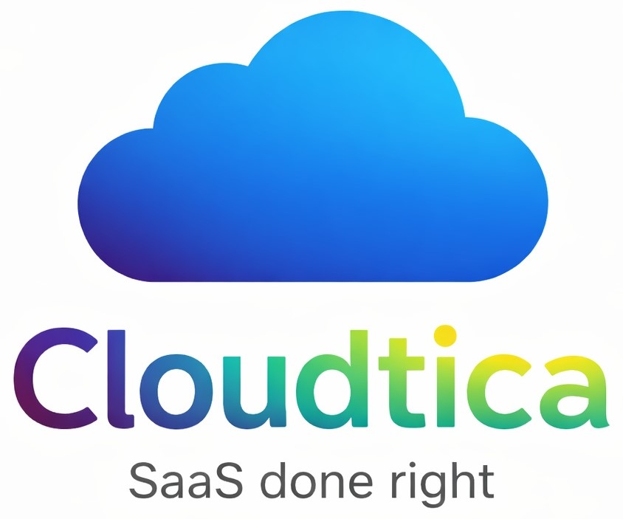
Python, SQL, POWER BI
Cloudtica SaaS end-to-end Data Analysis
Created by : Snehal Prasad

Slide 2

Business Problem
Cloudtica a B2B SaaS company, lacked a centralized analytics system to monitor sales performance, profitability, customer retention, and regional growth. The company needed a data-driven solution to identify high-performing products, optimize discount strategies, improve customer retention, and support strategic business decisions through interactive dashboards and business insights.

Slide 3

DATASET OVERVIEW
Raw Dataset
Cleaned Dataset

Slide 4

Workflow
Data Extract
  sourced data from Kaggle
Data Transformation
Clean and preprocess data using Python (Pandas and NumPy).
Handle missing values, corrected data types, standardized formats and removed inconsistencies.
Exploratory Data Analysis (EDA)
  Understand key patterns in sales, profits, discounts, and customer segments.
  Performed Descriptive Statistics Outlier, Detection (IQR Method) and Correlation Analysis
Data Warehousing
  Loaded Cleaned data into MySQL database
  Executed analytical SQL queries to extract insights from the dataset
Business Intelligence Dashboard
  Designed and Developed an interactive Power BI Dashboard to monitor key business metrics.
  Delivered actionable visual insights to support data-driven decision-making.

Slide 5

Tech Stack
Python
Data Cleaning and EDA
Tools & Libraries: Pandas, NumPy, Matplotlib, Seaborn, and Jupyter Notebook
SQL
Data Storage & Business Queries
Database used: MySQL
Import cleaned dataset into SQL database
Power BI
Data Visualization & Dashboard
DAX (Data Analysis Expression) – Created multiple DAX measures used for calculated memory, dynamic visuals, and conditional logic.
KPI cards
Data loading and preprocessing
Handling missing values
Removing duplicates
Outlier detection and treatment
Data transformation and feature creation
Perform multiple analytical queries
Simulate real-world business data analysis scenarios
Dynamic slicers
Cross filtering
Trend analysis
Interactive visuals

Slide 6

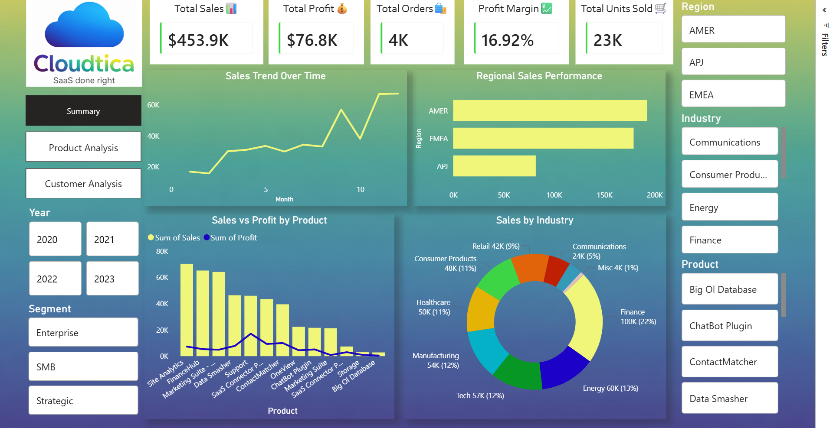
Dashboard Screenshot
KPIs
Positive upward sales trend indicating growing customer demand and successful sales initiatives
Slicers
Products such as Site Analytics, FinanceHub, Marketing Suite – Gold generate the highest sales. Whereas, several products contribute relatively low revenue, indicating product optimization, targeted marketing.
The AMER region generated the highest sales(~$192K), significantly outperforming EMEA and APJ. This suggests that AMER is the company’s strongest market and should remain a key focus area.

Slide 7
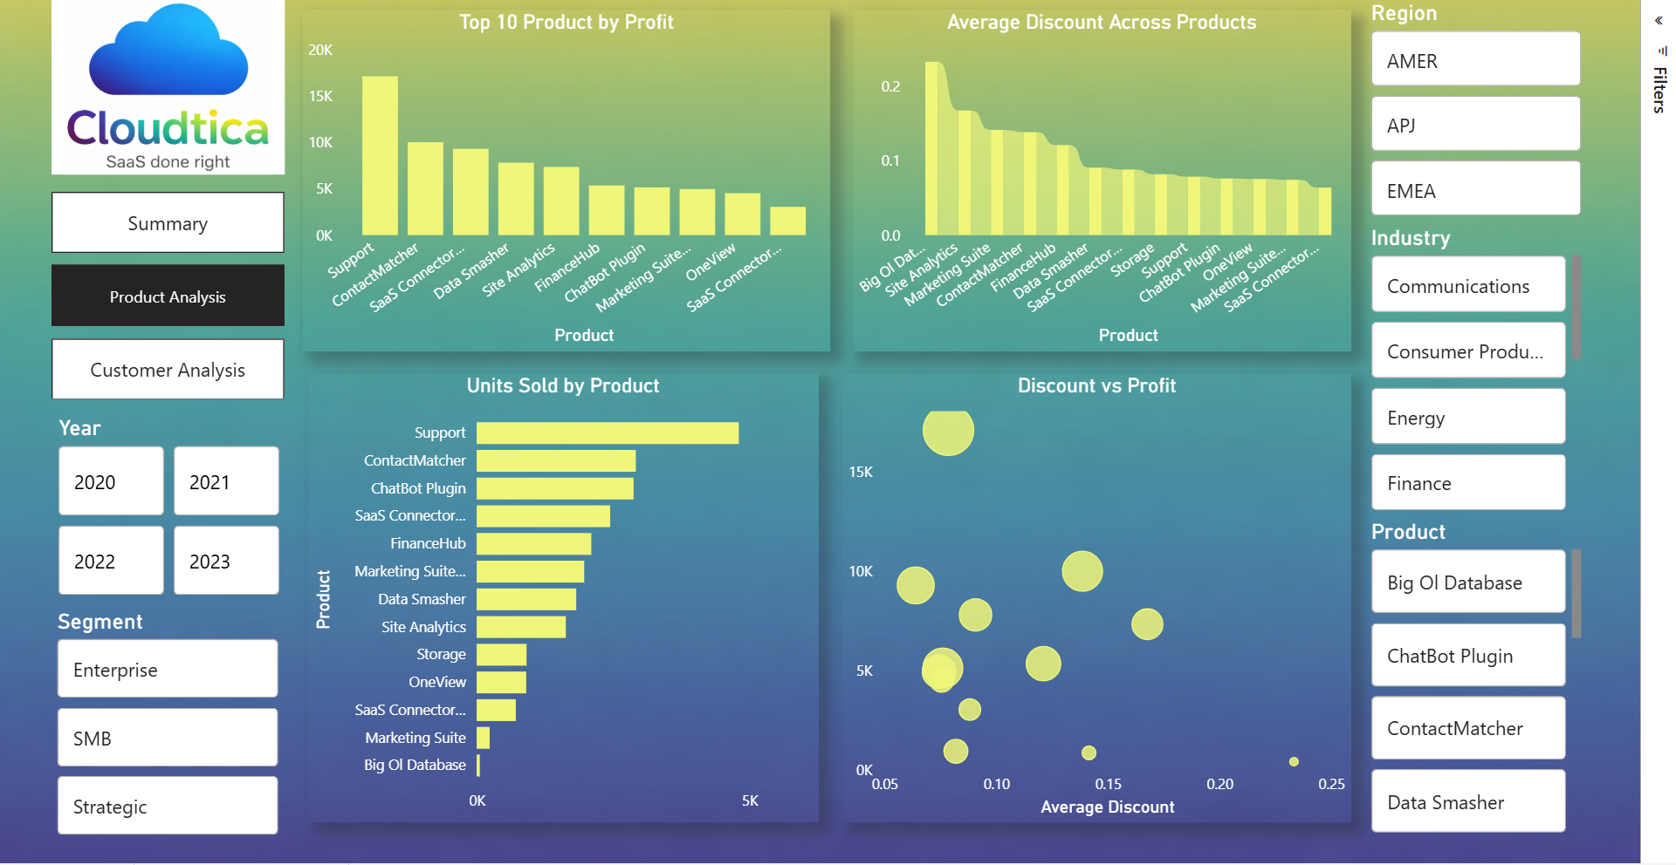
The “Top 10 Product by Profit” chart shows that Support generates the highest profit, followed by ContactMatcher, making them key revenue-driving products.
Dashboard Screenshot
Bubble Chart
Higher discounts do not always increase profit
From this “Discount vs Profit” bubble chart, products with moderate discounts achieve better profits, while very high discounts are associated with lower profitability.
This chart indicates that Support leads in sales volume, suggesting strong customer demand and market adoption.

Slide 8
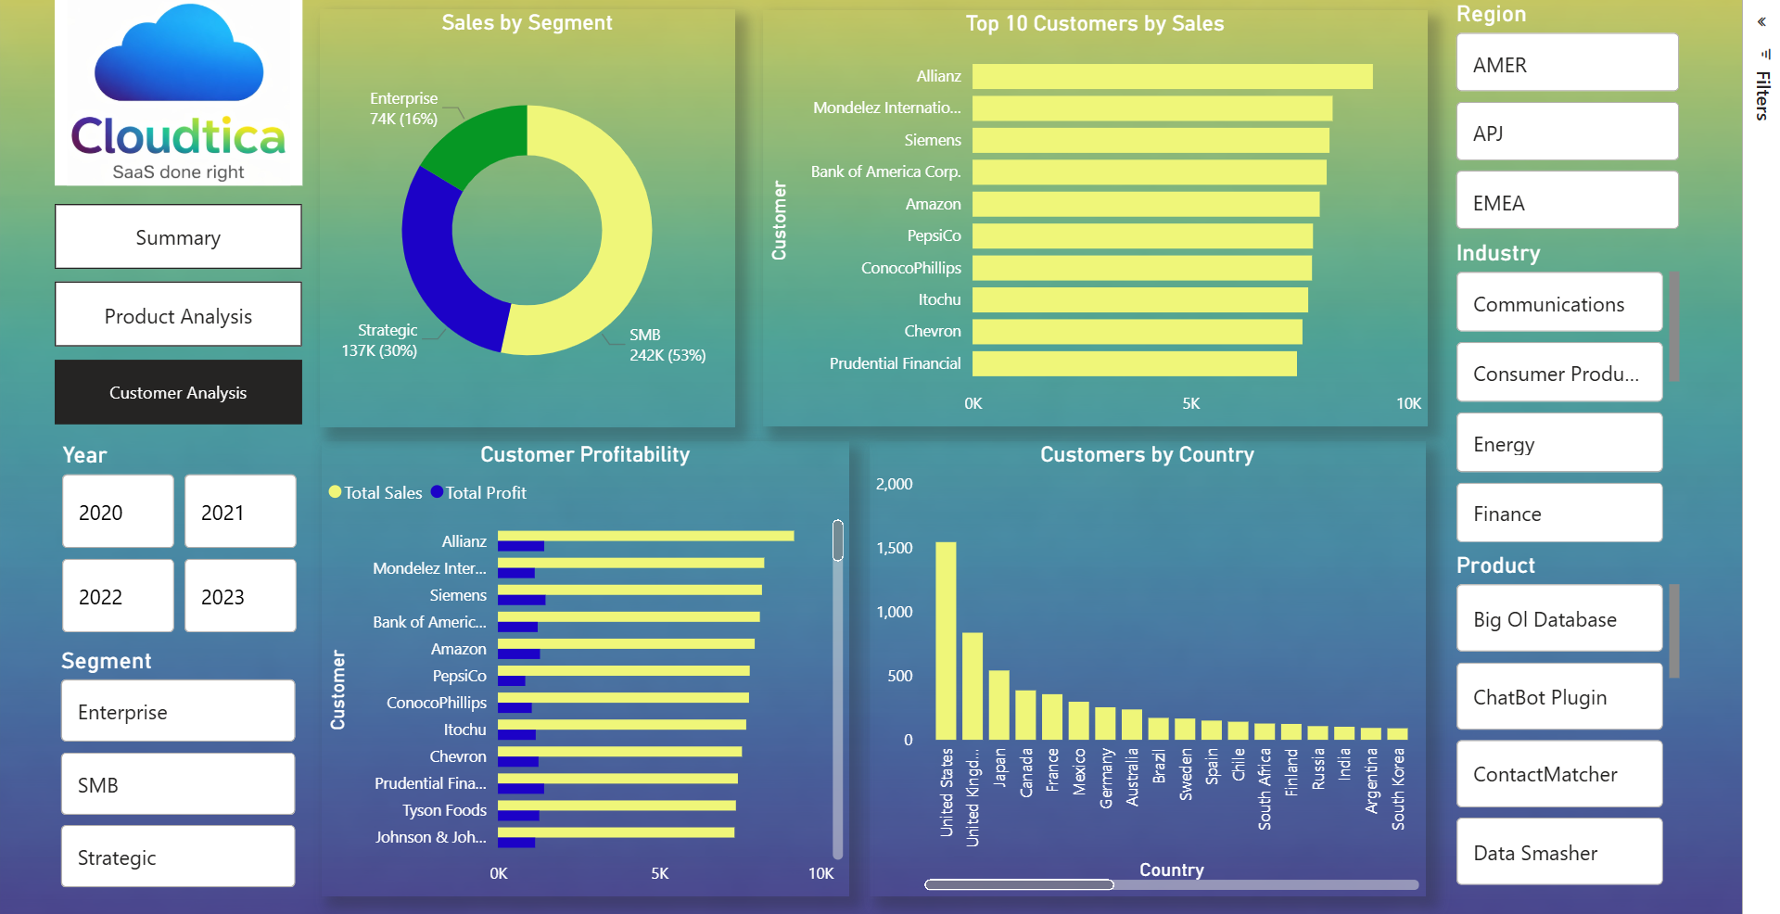
The SMB segment contributes 242K sales (53%), making it the largest customer segment. This indicates Cloudtica’s revenue is heavily dependent on SMB segment, so retaining and expanding this segment should be priority
Dashboard Screenshot
Allianz is the highest revenue-generating customer, followed by Mondelez International and Siemens. They contribute a significant share of total sales. Losing any of these customers could have a impact on overall revenue.
The Unites States has the highest number of customers, significantly exceeding all other countries. This suggest strong market penetration in the U.S. and potential growth opportunities in the other countries to diversify revenue sources.

Slide 9

Business Impact & Key Insights
Product Strategy
This project identifies which SaaS products generate the highest revenue and profit, helping the company focus on high-performing offerings.
Pricing & Discount Optimization
By analysing the relationship between discounts and profit, the company can refine discount strategies to avoid unnecessary margin loss.
Customer Relationship Management
Regional Expansion
Market Segmentation
SMB Segment Dominates Sales
Certain Products Generate Higher Profit Margins
Discounts Impact Profitability
Regional Sales Distribution
Revenue Concentration in Top Customers
A small number of customers generate a significant share of total revenue, emphasizing the importance of maintaining strong relationships with key accounts.
Identifying top customers allows the company to strengthen relationships with high-value clients and improve retention strategies.
Understanding regional sales distribution helps determine where the company should expand its marketing and sales efforts.
Insights into industry and segment performance allow the company to better target high-potential markets.
The SMB segment contributes the largest share of total sales, indicating strong demand from small and medium-sized businesses.
Products such as Support and ContactMatcher show higher profitability compared to others, indicating strong pricing power.
Higher discounts do not always result in higher sales and often reduce profit margins, highlighting the need for optimized discount strategies.
The AMER region contributes the largest portion of sales, followed by EMEA and APJ, indicating strong market presence in North America.

Slide 10

Recommendations
Focus on High-Profit Products:
Products generating the highest profit margins should receive increased marketing and sales focus.
Strengthen Relationships with Key Customers:
Since top customers contribute significantly to revenue, implementing loyalty programs and dedicated account management could improve retention.
Optimize Discount Strategy::
The company should carefully manage discount levels to maintain profitability while still attracting customers.
Expand in High-Growth Regions:
Regions showing consistent growth should be prioritized for expansion and targeted marketing campaigns.
Industry Targeting:
Industries generating strong revenue should receive specialized product bundles or tailored SaaS solutions.

Slide 11

Conclusion
This project demonstrates how raw business data can be transformed into actionable insights using a complete data analytics workflow. Through data cleaning, exploratory data analysis, database querying and interactive visualization, this project provides a comprehensive view of sales performance, product profitability, and customer behaviour. The Power BI dashboard enables stakeholders to monitor key performance indicators, identify growth opportunities, and make data-driven business decisions. Overall, this project highlights the importance of data-driven decision making in SaaS B2B businesses and showcases practical skills in Python, SQL, and Power BI.

Slide 12


THANK YOU

